Slide 1
Women who are current smokers and have been smoking for more than 10 years appear to have about a 10 percent higher risk of breast cancer than women who never smoked.

Slide 2
Bladder cancer Breast cancer Cervical cancer Colon cancer Esophageal cancer
SMOKING RISKS
Kidney cancer
Larynx cancer
Liver cancer
Lung cancer
Pancreatic cancer
Stomach cancer

Slide 3
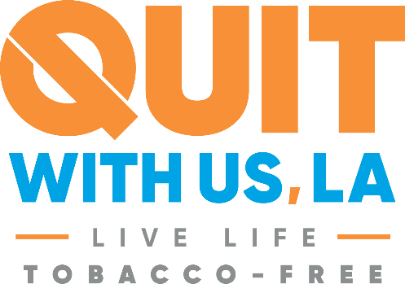
Louisiana Tobacco Quitline 1-800-QUIT-NOW

Slide 4
LIVE VAPE FREE
Text VAPEFREE to 873373

